Slide 1
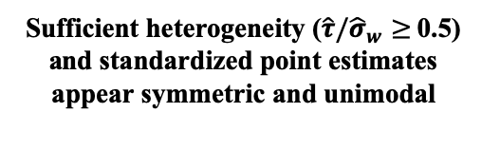
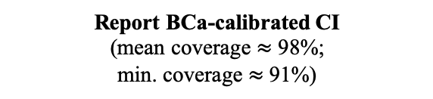
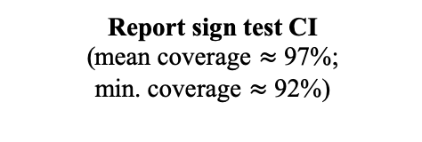
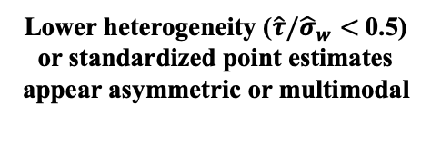
Attempt BCa-calibrated CI
Converges
(78% of all simulations)
Fails to converge
(22% of all simulations)
Report BCa-calibrated CI
(mean coverage $≈$ 98%;
min. coverage $≈$ 91%)
Sufficient heterogeneity ($\hat{τ}/{\hat{σ}}_{w}≥$0.5) and standardized point estimates appear symmetric and unimodal
Lower heterogeneity ($\hat{τ}/{\hat{σ}}_{w}<$ 0.5) or standardized point estimates appear asymmetric or multimodal
Report sign test CI
(mean coverage $≈$ 97%;
min. coverage $≈$ 92%)
Do not report inference

